Slide 1



PROGRAMMING FUNDAMENTALS IN C
Problem Solving

Slide 2
Motivation
Problem solving involves finding a solution for a given problem
The sport of your brain
Coder
Problem Solver
YOU

Slide 3
Motivation
Coding: writing code
Problem Solving: finding a solution to a problem
Coder
Problem Solver
YOU

Slide 4



Motivation
Problem solving contests
ACM-ICPC
Google Code Jam
Facebook Hacker Cup

Slide 5
Objectives
Understand what is problem solving
How to solve problems using flow chart and pseudocode
Train you to solve problems
Building source program using cmd

Slide 6
Problem Solving
Strategies for Problem Solving
Flow chart and Pseudocode
Exercises
Writing and executing application manually

Slide 7
Strategies for Problem Solving
Spend more time on understanding and solving the problem.
Example: improving the performance of ticket registration system
Understand the problem
Write code
Find Solution

Slide 8
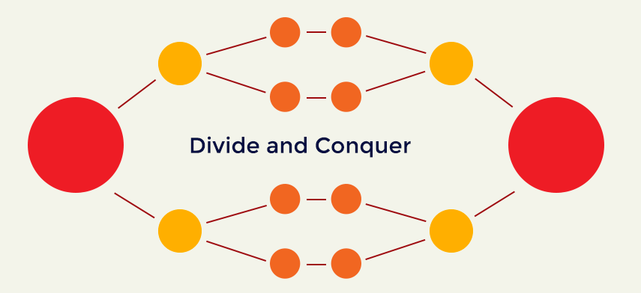
Strategies for Problem Solving
Determine INPUT and OUTPUT
Divide and conquer.
Break a BIG problems into smaller problems.
Small problems are easier to solve.
Combine the solution together.

Slide 9
Strategies for Problem Solving
TRY AGAIN and AGAIN
Experiment your solution
Plug in some inputs.
Follow your solution.
Check if the output is correct.
Solution
Input
Output

Slide 10
QUIZ
Seven friends had a gathering. Each one of them shook hands with all others once. How many handshakes were there?
 | A | B | C | D | E | F | G
A
B | *
C | * | *
D | * | * | *
E | * | * | * | *
F | * | * | * | * | *
G | * | * | * | * | * | *
Sum | 6 | 5 | 4 | 3 | 2 | 1 | 0
Total = 6 + 5 + 4 + 3 + 2 + 1 = 21 handshakes.

Slide 11
Problem Solving
Strategies for Problem Solving
Flow Chart and Pseudocode
Exercises
Writing and Executing an Application Manually

Slide 12
Pseudocode
Pseudocode: plain language description of the steps in an algorithm.
Informal language that helps programmers develop algorithms.
Example: Sum of 3 numbers entered by user.
DEFINE: x, y, z
READ: x, y, z
COMPUTE: sum = x + y+ z
OUTPUT: sum

Slide 13
Pseudocode
The main constructs of pseudocode:
SEQUENCE represents linear tasks sequentially performed one after the other.
WHILE a loop with a condition at its beginning.
REPEAT-UNTIL a loop with a condition at the bottom.
FOR another way of looping.
IF-THEN-ELSE a conditional statement changing the flow of the algorithm.
CASE the generalization form of IF-THEN-ELSE.

Slide 14
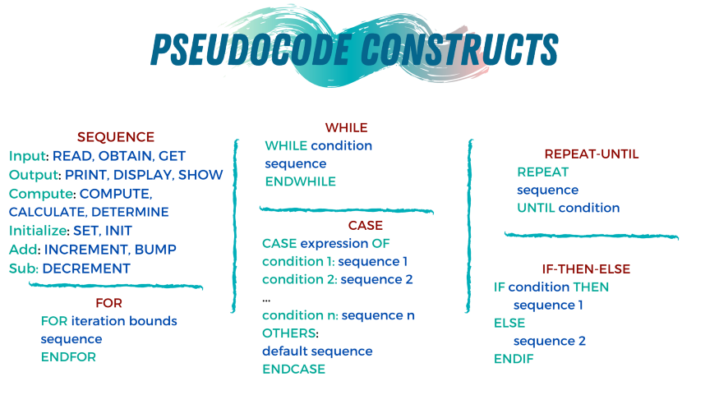
Pseudocode
The main constructs of pseudocode:

Slide 15

Pseudocode
Example: Find the largest among three different numbers $x, y, z$ entered by the user.
DEFINE: x, y, z
READ: x, y, z
IF: x > y
IF: x > z
OUTPUT: x
ELSE
OUTPUT: z
ELSE
IF: y > z
OUTPUT: y
ELSE
OUTPUT: z

Slide 16
Flow Chart
A flowchart is a graphical representation of steps.
Shows steps in sequential order.
Flowline | Shows the process's order of operation.
Terminal | Indicates the beginning and ending of a program
Process | Represents a set of operations that changes value, form, or location of data.
Decision | Shows a conditional operation that determines which one of the two paths the program will take.
Input/Output | Indicates the process of inputting and outputting data
On-page Connector | Pairs of labeled connectors replace long or confusing lines on a flowchart page.
Off-page Connector | A labeled connector for use when the target is on another page.

Slide 17
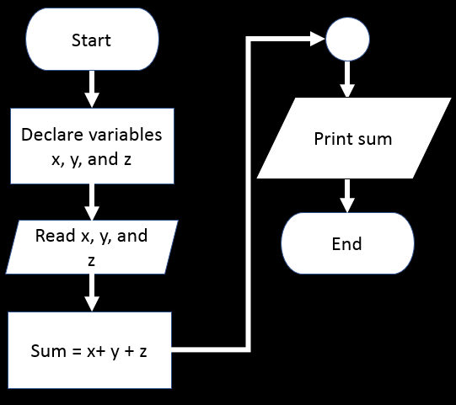
Flow Chart-EDIT
Example: Flow chart for adding 3 numbers
DEFINE: x, y, z
READ: x, y, z
COMPUTE: sum = x + y+ z
OUTPUT: sum

Slide 18
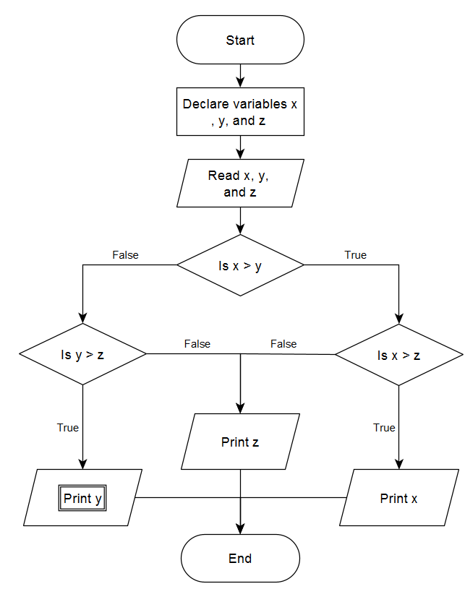
Flow Chart
Example: Find the largest among three different numbers entered by the user.
DEFINE: x, y, z
READ: x, y, z
IF: x > y
IF: x > z
OUTPUT: x
ELSE
OUTPUT: z
ELSE
IF: y > z
OUTPUT: y
ELSE
OUTPUT: z

Slide 19
Problem Solving
Strategies for Problem Solving
Flow Chart and Pseudocode
Exercises
Writing and Executing an Application Manually

Slide 20
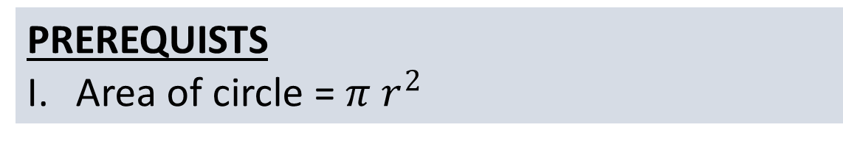

Exercise #1
Write a program that takes the radius of the circle $r$from user and output the area of circle.
PREREQUISTS
Area of circle = $π r^{2}$

Slide 21
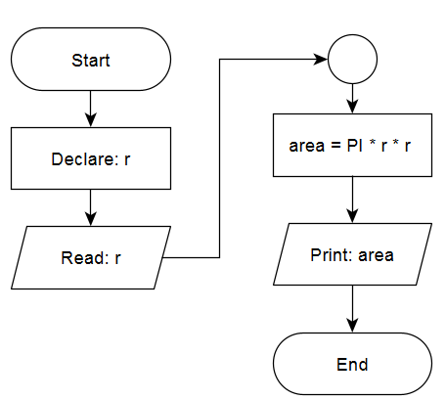

ANSWER #1
Problem: write a program that takes the radius of the circle from user $r$ and output the area of circle.
Input: radius $r$
Output: $area$
DECLARE: r
READ: r
COMPUTE: area = PI * r * r
OUTPUT: area

Slide 22



EXERCISE #2
Given two variables $x$ and $y$, each stores its own value. Swap the values of the two variables.
$$X$$
$$Y$$
5
10
Before swapping
10
5
After swapping

Slide 23
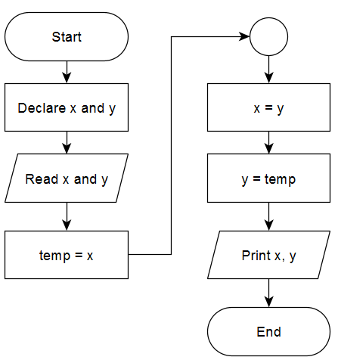

ANSWER #2
Given two variables $x$ and $y$, each stores its own value. Swap the values of the two variables.
Input: 𝑥 and 𝑦.
Output: 𝑥 has the value of 𝑦, and 𝑦 has the value of 𝑥.
DEFINE: x , y
READ: x, y
DEFINE: temp = x
SET: x = y
SET: y = temp
OUTPUT: x, y

Slide 24

Exercise #3-TASK
Given two variables $x$ and $y$, each stores its own value. Swap the values of the two variables. (DON’T use a third variables)
PREREQUISTS
Basic mathematical operations

Slide 25
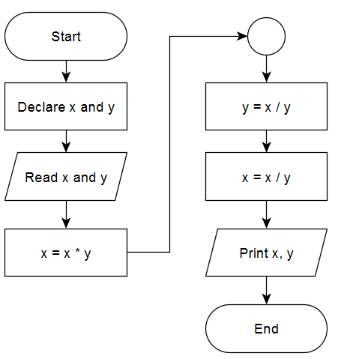

Answer #3
Given two variables $x$ and $y$, each stores its own value. Swap the values of the two variables. (DON’T use a third variables)
The idea is to use two opposite mathematical operations
DEFINE: x , y
READ: x, y
SET: x = x * y
SET: y = x / y
SET: x = x / y
OUTPUT: x, y

Slide 26

EXERCISE #4
Write a program that takes 2 integer numbers (𝑥, 𝑦). Check if 𝑦 is a multiple of 𝑥 or not. If it is multiple, output the result of division otherwise output “Not Multiple”.
Note: $y$ is multiple of $x$ when we multiply $x$ to a specific value $z$ and equals $y$. $(x∗z = y)$
PREREQUISTS
Basic mathematical operations

Slide 27
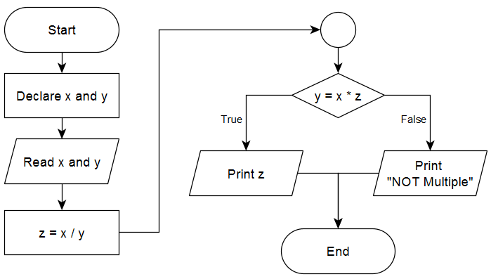

Answer #4
Write a program that takes 2 integer numbers ($x, y$). Check if $y$ is a multiple of $x$ or not. If it is multiple, output the result of division otherwise output “Not Multiple”.
Input: $x, y$
Output: x / y, or “Not Multiple”
DEFINE: x , y
READ: x, y
COMPUTE: z = x / y
IF: z * x == y
OUTPUT: z
ELSE
OUTPUT: “NOT Multiple

Slide 28
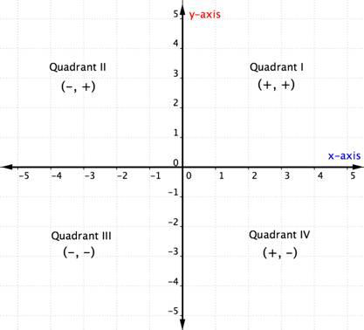
Exercise #5
Given two numbers X, Y which donate coordinates of a point in 2D plan. Determine in which quarter it belongs.
Output Q1, Q2, Q3, Q4 according to the quarter in which the point belongs to.
Output "Origin" If the point is at the origin.
Output "X-axis" If the point is over X axis.
Output "Y-axis" if the point is over Y axis.

Slide 29

Answer #5
Given two numbers $X, Y$which donate coordinates of a point in 2D plan. Determine in which quarter it belongs.
Input: $X, Y$
Output: Point’s Location
DEFINE: x , y
READ: x, y
IF: x is + and y is +
OUTPUT: Q1
ELSE-IF: x is – and y is +
OUTPUT: Q2
ELSE-IF: x is - and y is –
OUTPUT: Q3
ELSE-IF: x is + and y is -
OUTPUT: Q4
ELSE-IF: x is 0 and y is 0
OUTPUT: origin
ELSE-IF: (x is + or - ) and y is 0
OUTPUT: x-axis
ELSE-IF: x is 0 and (y is + or -)
OUTPUT: y-axis

Slide 30
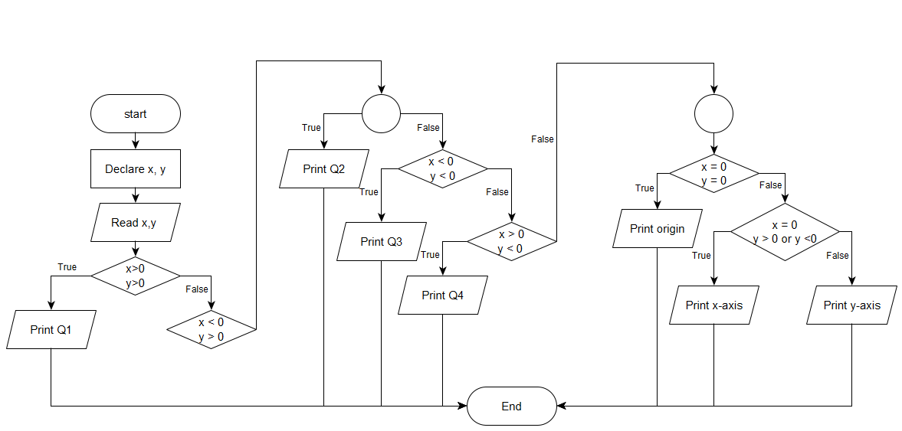
Answer #5 cont.

Slide 31
Exercise #6
Write an algorithm to determine whether a given input is a character (upper or lower) or a number.
PREREQUISTS
Knowledge of ASCII tables

Slide 32
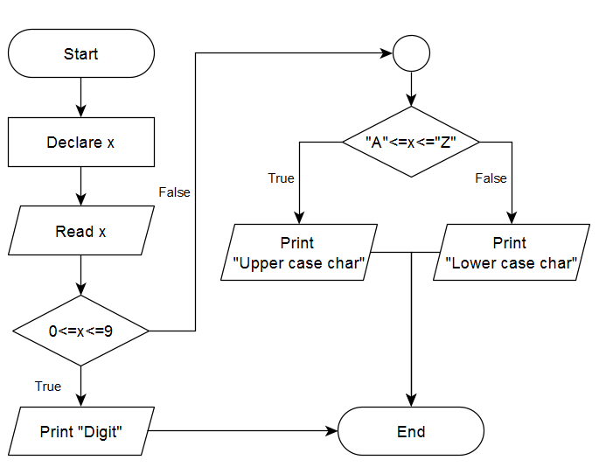

Answer #6-TASK
Write an algorithm to determine whether a given input is a character (upper or lower) or a digit.
Input: a variable $x$
Output: a digit or a character
DEFINE: x
READ: x
IF: 0<=x<=9
OUTPUT: “Digit”
ELSE
IF: “A”<=x<=“Z”
OUTPUT: “Upper case character”
ELSE
OUTPUT: “Lower case character”

Slide 33

EXERCISE #7
Suppose $a, b, c$ are coefficients of the quadratic equation $ax^{2}+bx+c$. Determine if the formula is solvable and has real roots. If the formula is solvable, print “Solvable”. Otherwise, print “Not-solvable”
The quadratic formula is: $\frac{−b ± \sqrt{b^{2}−4ac}}{2a}$
PREREQUISTS
Basic mathematical operations

Slide 34

Answer #7-TASK
Suppose $a, b, c$ are coefficients of the quadratic equation $ax^{2}+bx+c$. Determine if the formula is solvable and has real roots. If the formula is solvable, print “Solvable”. Otherwise, print “Not-solvable”
The quadratic formula is: $\frac{−b ± \sqrt{b^{2}−4ac}}{2a}$
Input: a, b, c
Output: “Solvable” or “Not solvable”

Slide 35
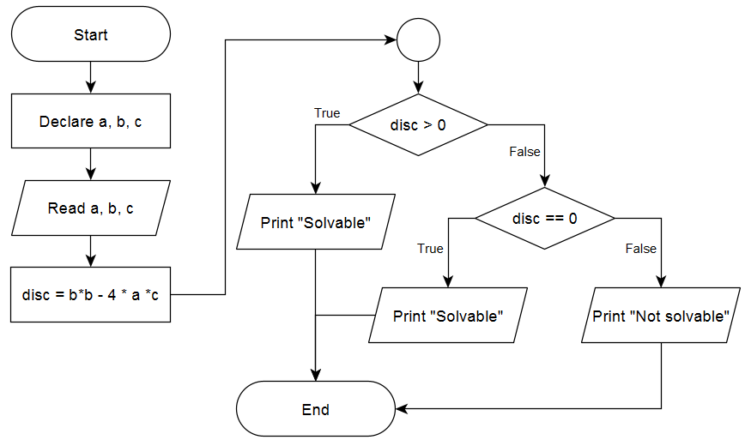
Answer #7 cont.
DEFINE: a, b, c
READ: a, b, c
COMPUTE: disc = b*b – 4 * a * c
IF: disc > 0
OUTPUT: “Solvable”
ELSE-IF: disc == 0
OUTPUT: “Solvable”
ELSE
OUTPUT: “Not Solvable”

Slide 36

EXERCISE #8-TASK
Write a program that gets input a number $n and$ print the results of the summation of the numbers from $0$ to $n$.
$\sum_{i=1}^{n}{i}$
PREREQUISTS
Loops

Slide 37
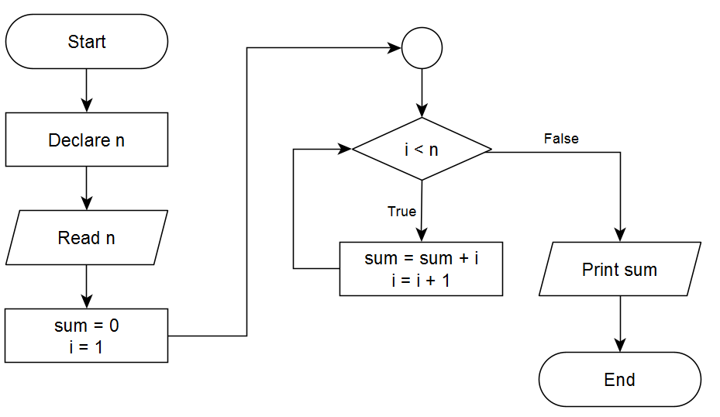

Answer #8
Write a program that gets input a number $n and$ print the results of the summation of the numbers from $0$ to $n$.
Input: $n$
Output: summation from 1 to $n$
DEFINE: n
READ: n
SET: sum = 0
SET: i = 1
FOR: i to n
sum = sum + i
OUTPUT: sum

Slide 38
Exercise #9-TASK
Given n numbers, find the maximum value.
PREREQUISTS
Loops and lists

Slide 39
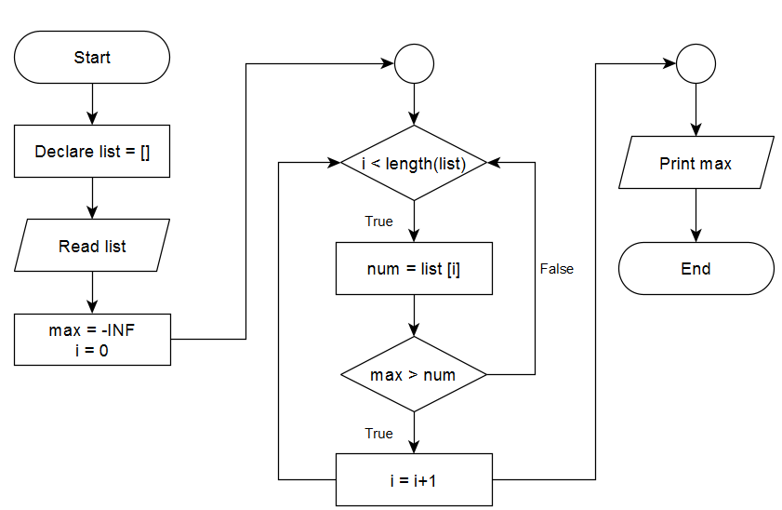

Answer #9
Given n numbers, find the maximum value.
Input: $n$ numbers
Output: the max number
DEFINE: list = []
READ: list
SET: max = -INF
DEFINE: i = 0
FOR: i to length(list)
COMPUTE: num = list[i]
IF: num > max
COMPUTE: max = num
OUTPUT: max

Slide 40

Exercise #10-TASK
Do you know Super Mario game? We changed the game rules, Mario instead of avoiding the monsters by jumping he will fight them all. But because he is very weak, always he loses the fight and loses his health. At the beginning of the game Mario starts with health $100$, then he fights $n$ monsters. Each monster $i$ has a power $x_{i}$ and when Mario fights it, his health will be decreased by $x_{i}$. While Mario health is a positive value, he still alive otherwise he dead. You will be given the number of monsters $n$ and the power of each monster $x_{i}$. Can you tell us if Mario will be alive or be dead after fighting all monsters.
PREREQUISTS
Loops and lists

Slide 41
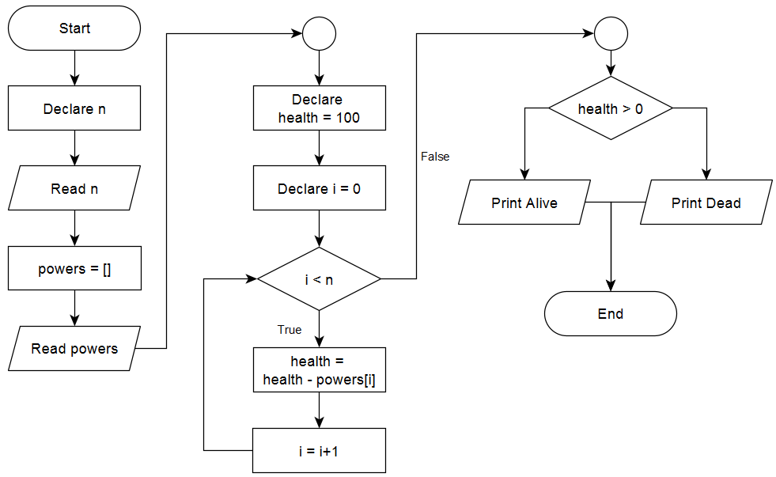

Answer #10
Input: number of monsters $n$ and each monster power $x_{i}$
Output: Mario is dead or alive
DEFINE: n
READ: n
DEFINE: powers = []
READ: powers
DEFINE: health = 100
FOR: i=0 to n
COMPUTE: health = health – powers[i]
IF: health > 0
OUTPUT: Alive
ELSE
OUTPUT: dead

Slide 42
Problem Solving
Strategies for Problem Solving
Flow Chart and Pseudocode
Exercises
Writing and Executing an Application Manually

Slide 43
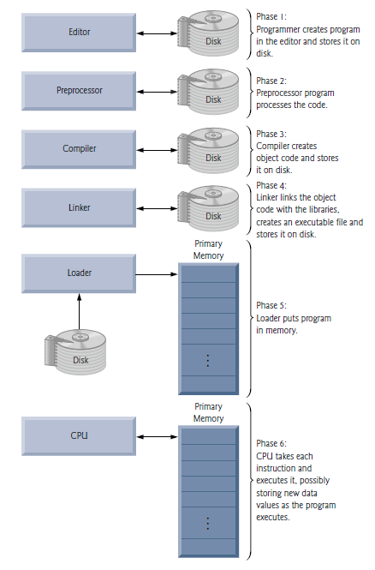
How source code is transformed into executable application

Slide 44
How source code is transformed into executable application
Write your code in a text file
In cmd, change current working directory to the directory of the source code
#include <stdio.h>
int main()
{
printf("Hello, World! \n");
return 0;
}
cd <PATH>

Slide 45
How source code is transformed into executable application
Compile the source code using GNU compiler
A .exe file appears
Run the application
Congratulations
gcc <CODE FILE.c>
<FILENAME.exe>

Slide 46
Some cmd commands
Command | Description
cd | Change directory
cls | Clear screen
date | Show date
echo | Re-outputs the text
ipconfig | display IP network settings
ping | Pings an IP
shutdown | shutdown the computer
exit | exits the command prompt

Slide 47
Task
Write a pseudocode and design a flowchart for a source code compilation and execution.
Solve Exercise #9 with WHILE loop instead of FOR loop
Explore another 5 commands for cmd.
What are NP problems?
What is Travelling Salesman problem?

Slide 48
Summary
Discovering the art of problem solving
Writing pseudocode
Drawing flowchart
Declaring variables
Expressing loops
Expressing conditional statements
Compiling and running C source code from scratch
A few cmd commands

